Slide 1
MATHEMATICAL FOUNDATION FOR COMPUTER SCIENCE
Prepared by: Er. Ankit Kharel
Nepal college of information technology

Slide 2
Graph Theory

Slide 3
GRAPHS:
Graphs are discrete structures consisting of vertices and edges that connect these vertices.
There are different kinds of graphs, depending on whether edges have directions, whether multiple edges can connect the same pair of vertices, and whether loops are allowed.
A graph G = (V , E) consists of V , a nonempty set of vertices (or nodes) and E, a set of edges. Each edge has either one or two vertices associated with it, called its endpoints. An edge is said to connect its endpoints.
The set of vertices V of a graph G may be infinite. A graph with an infinite vertex set or an infinite number of edges is called an infinite graph, and in comparison, a graph with a finite vertex set and a finite edge set is called a finite graph. I
A
B
A
B
B
D
C

Slide 4
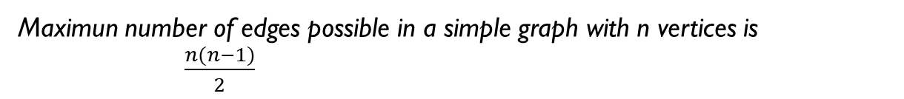
TYPEs of graphs:
Undirected Graph: A Graph whose edges are undirected is called undirected Graph
Simple Graph: A graph in which each edge connects to the two different vertices and no two edges connect same pair of vertices is called a Simple Graph[no- parallel edges and no loops]
Multi Graph: If in a graph multiple edges between the same set of vertices are allowed, it is called multigraph.
Pseudo Graph : It is a multigraph with loops.
A
B
Maximun number of edges possible in a simple graph with n vertices is
$\frac{n(n−1)}{2}$
C
A
B
C
A
B
C

Slide 5
TYPEs of graphs:
Directed Graph: A Graph whose edges are directed is called directed Graph
Simple Directed Graph: A directed graph in which each edge connects to the two different vertices and no two edges connect same pair of vertices is called a Simple Graph[no- parallel edges and no loops]
Multiple Directed Graph: If in a Directed graph multiple edges between the same set of vertices and loops are allowed, it is called multigraph.
2. Mixed Graph: A graph with both directed and undirected edges is called a mixed graph.
A
B
C
A
B
C

Slide 6
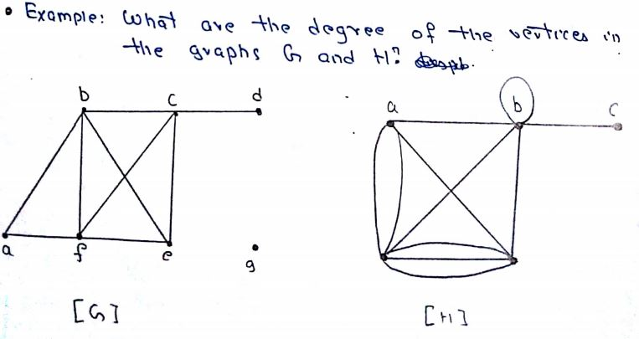
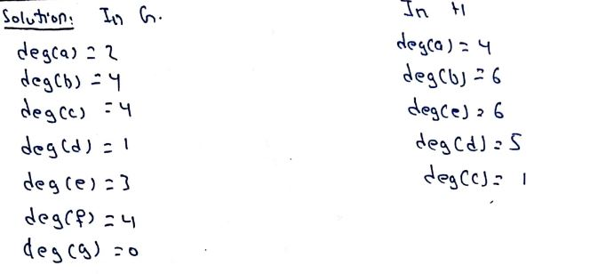
Graph terminologies:
First, we give some terminology that describes the vertices and edges of undirected graphs
Two vertices u and v in an undirected graph G are called adjacent (or neighbors) in G if u and v are endpoints of an edge e of G. Such an edge e is called incident with the vertices u and v and e is said to connect u and v.
The degree of a vertex in an undirected graph is the number of edges incident with it, except that a loop at a vertex contributes twice to the degree of that vertex. The degree of the vertex v is denoted by deg(v).

Slide 7
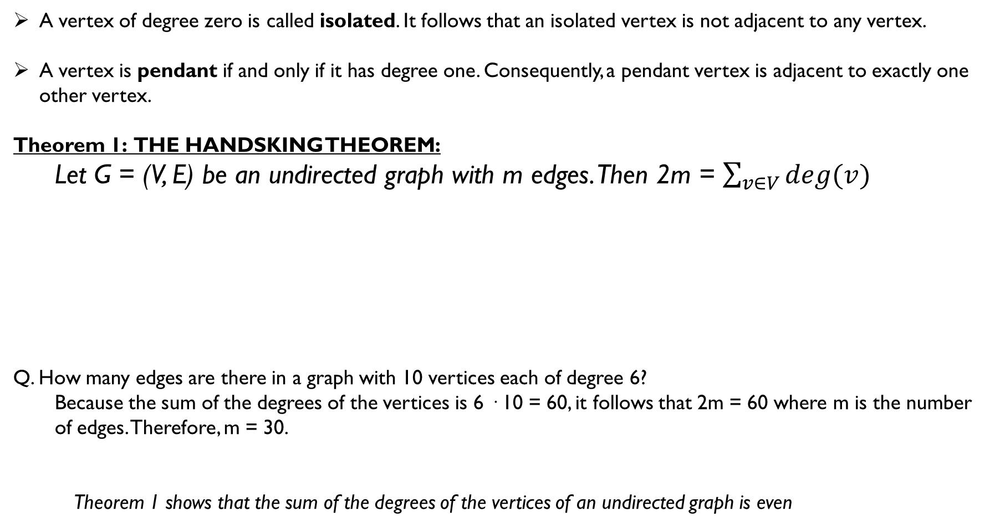
Graph terminologies:
A vertex of degree zero is called isolated. It follows that an isolated vertex is not adjacent to any vertex.
A vertex is pendant if and only if it has degree one. Consequently, a pendant vertex is adjacent to exactly one other vertex.
Theorem 1: THE HANDSKING THEOREM:
Let G = (V, E) be an undirected graph with m edges. Then 2m = $\sum_{v∈V}{deg⁡(v)}$
Q. How many edges are there in a graph with 10 vertices each of degree 6?
Because the sum of the degrees of the vertices is 6 · 10 = 60, it follows that 2m = 60 where m is the number of edges. Therefore, m = 30.
Theorem 1 shows that the sum of the degrees of the vertices of an undirected graph is even
A
B
A
C
2*5 = 3+3+4
10=10
2*3 = 2+2+2
6=6
C
B

Slide 8
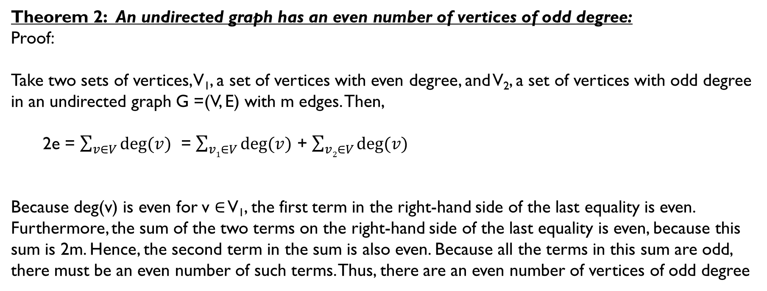
Graph terminologies:
Theorem 2: An undirected graph has an even number of vertices of odd degree:
Proof:
Take two sets of vertices, V₁, a set of vertices with even degree, and V₂, a set of vertices with odd degree in an undirected graph G =(V, E) with m edges. Then,
2e = $\sum_{v∈V}{deg⁡(v)}$ = $\sum_{v1∈V}{deg⁡(v)}$ + $\sum_{v2∈V}{deg⁡(v)}$
Because deg(v) is even for v ∈ V₁, the first term in the right-hand side of the last equality is even. Furthermore, the sum of the two terms on the right-hand side of the last equality is even, because this sum is 2m. Hence, the second term in the sum is also even. Because all the terms in this sum are odd, there must be an even number of such terms. Thus, there are an even number of vertices of odd degree

Slide 9
Graph terminologies:
Terminology for graphs with directed edges reflects the fact that edges in directed graphs have directions.
Let (u, v) be an edge representing edge of a directed graph G. u is called adjacent to v and v is called adjacent from u. The vertex u is called initial vertex and the vertex v is called terminal or end vertex. Loop has same initial and terminal vertex.
In directed graph the in-degree of a vertex v, denoted by deg⁻ (v) , is the number of edges that have v as their terminal vertex(incoming edges). The out-degree of a vertex v, denoted by deg⁺ (v), is the number of edges that have v as their initial vertex(outgoing edges). (Note that a loop at a vertex contributes 1 to both the in-degree and the out-degree of this vertex.)

Slide 10
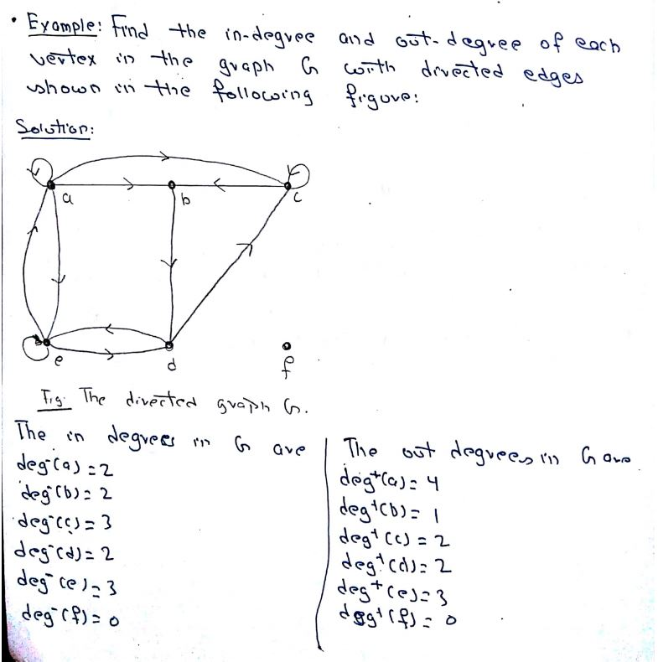
Graph terminologies:

Slide 11
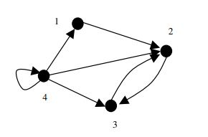
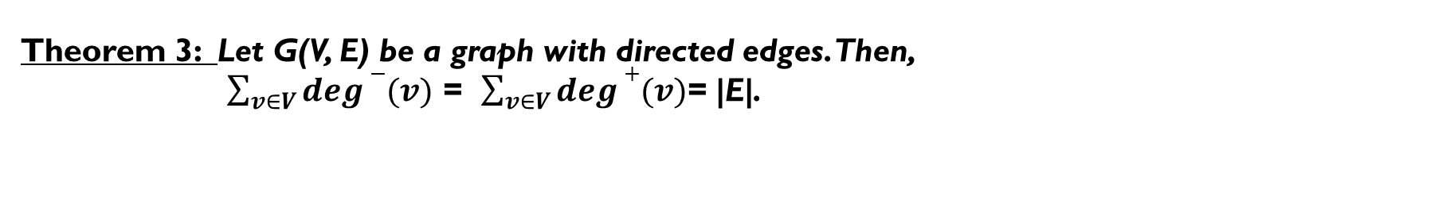
Graph terminologies:
Theorem 3: Let G(V, E) be a graph with directed edges. Then,
$\sum_{v∈V}{deg⁡−(v)}$ = $\sum_{v∈V}{deg⁡+(v)}$= |E|.
Sum of in-degree =1+1+3+2 =7
Sum of out-degree= 1+1+1+4 =7
Total edges = 7

Slide 12
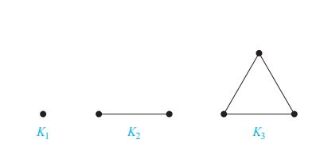
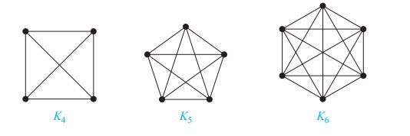
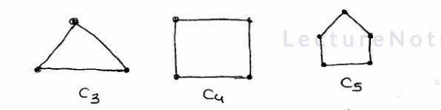

Some special types of graphs:
Complete Graph: A complete graph on n vertices, denoted by K_{n}, is a simple graph that contains exactly one edge between each pair of distinct vertices. The graphs K_{n}, for n = 1, 2, 3, 4, 5, 6, are displayed in below Figures.
A complete graph is a regular graph but every regular graph is not complete graph
A complete graph is a simple graph with max number of edges
Number of edges in K_{n}= $\frac{n(n−1)}{2}$
Degree of each vertex = (n-1)
Cycle Graph: A graph G with n vertices (n>=3) and n edges , is called a cycle graph(C_{n}) , if all edges form
cycle of length n.

Slide 13
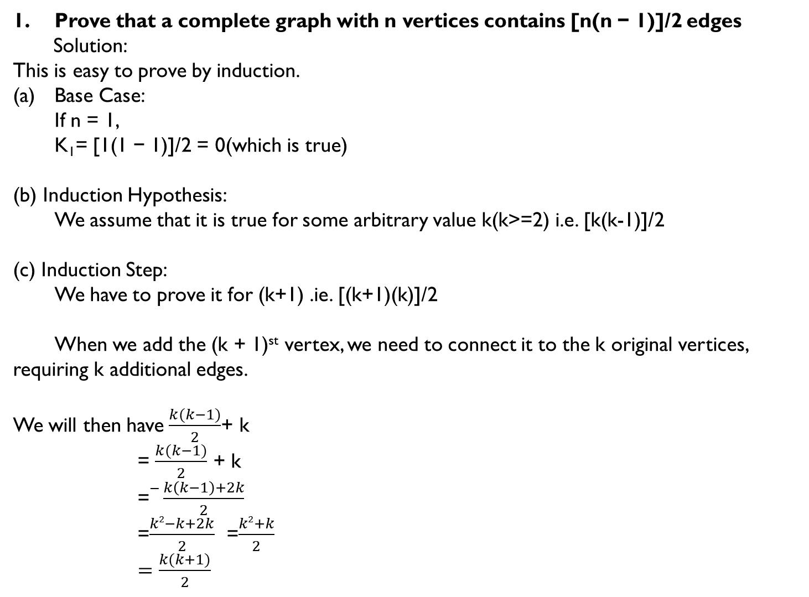
Prove that a complete graph with n vertices contains [n(n − 1)]/2 edges
Solution:
This is easy to prove by induction.
Base Case:
If n = 1,
K₁= [1(1 − 1)]/2 = 0(which is true)
(b) Induction Hypothesis:
We assume that it is true for some arbitrary value k(k>=2) i.e. [k(k-1)]/2
(c) Induction Step:
We have to prove it for (k+1) .ie. [(k+1)(k)]/2
When we add the (k + 1)^{st} vertex, we need to connect it to the k original vertices, requiring k additional edges.
We will then have $\frac{k(k−1)}{2}$+ k
= $\frac{k(k−1)}{2}$ + k
=$−\frac{k\left(k−1\right)+2k}{2}$
=$\frac{k2−k+2k}{2}$ =$\frac{k2+k}{2}$
$=\frac{k(k+1)}{2}$

Slide 14
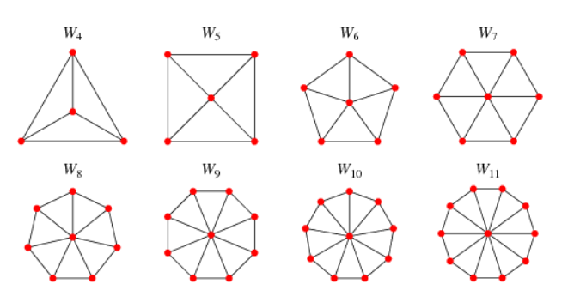
Some special types of graphs:
3. Wheel Graph: A wheel graph W_{n} of n vertices(n>=4) can be formed from a cycle graph C_{n-1} by adding a new vertex(hub) which is adjacent to all vertices of C_{n-1}. . The wheel graphs are displayed below.
Number of edges in W_{n} = 2(n-1)

Slide 15
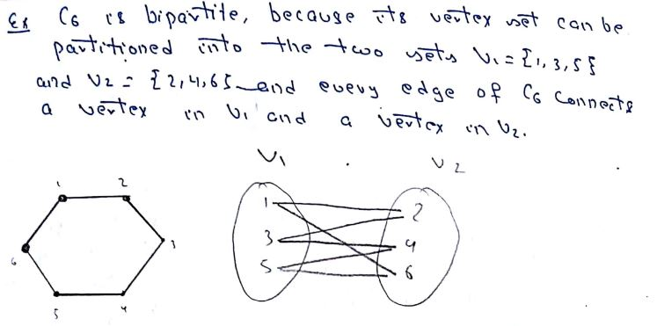
Some special types of graphs:
4. Bipartite Graphs: A simple graph G is called bipartite if its vertex set V can be partitioned into two disjoint sets V₁ and V₂ such that every edge in the graph connects a vertex in V₁ and a vertex in V₂ (so that no edge in G connects either two vertices in V₁ or two vertices in V₂). When this condition holds, we call the pair (V₁, V₂) a bipartition of the vertex set V of G.

Slide 16
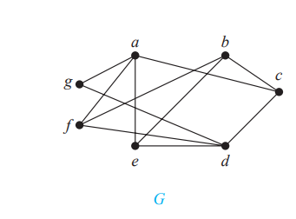
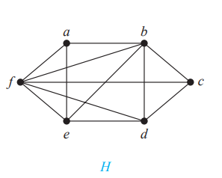
Some special types of graphs:
Theorem 4 : A simple graph is bipartite if and only if it is possible to assign one of two different colors to each vertex of the graph so that no two adjacent vertices are assigned the same color.
The chromatic number of the following bipartite graph is 2.
Is G and H bipartite graph??

Slide 17
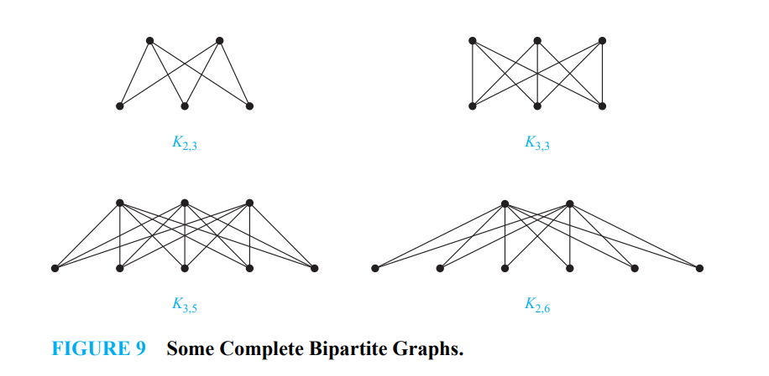
Some special types of graphs:
5. Complete Bipartite Graphs: A complete bipartite K_{m,n} graph is a special type of bipartite graph where every vertex of one set is connected to every vertex of another set.

Slide 18
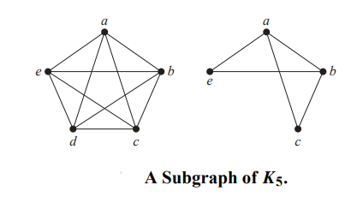
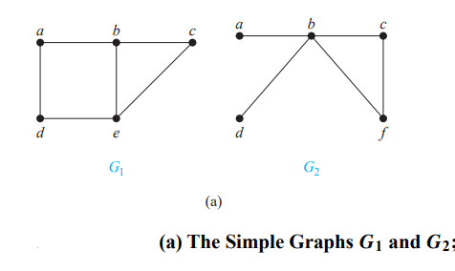
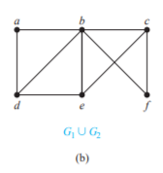
Some special types of graphs:
Subgraph Graphs: A subgraph of a graph G = (V , E) is a graph H = (W, F ), where W ⊆ V and F ⊆ E. A subgraph H of G is a proper subgraph of G if H != G
GRAPH UNIONS: Two or more graphs can be combined in various ways. The new graph that contains all the vertices and edges of these graphs is called the union of the graphs.The union of two simple graphs G₁ = (V₁, E₁) and G₂ = (V₂, E₂) is the simple graph with vertex set V₁ ∪ V₂ and edge set E₁ ∪ E₂. The union of G₁ and G₂ is denoted by G₁ ∪ G₂.

Slide 19
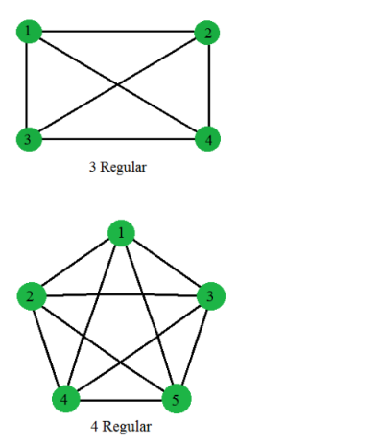
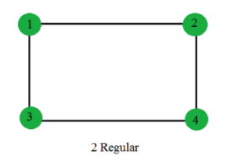
Some special types of graphs:
Regular Graphs: A graph is called regular graph if degree of each vertex is equal. A graph is called K regular if degree of each vertex in the graph is K.
A complete graph with N vertices is (N-1) regular.
Cycle(C_{n}) is always 2 Regular.
2 Regular

Slide 20
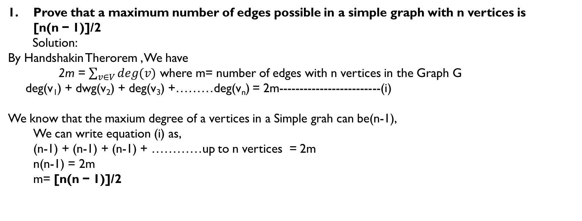
Prove that a maximum number of edges possible in a simple graph with n vertices is [n(n − 1)]/2
Solution:
By Handshakin Therorem , We have
2m = $\sum_{v∈V}{deg⁡(v)}$ where m= number of edges with n vertices in the Graph G
deg(v₁) + dwg(v₂) + deg(v₃) +………deg(v_{n}) = 2m-------------------------(i)
We know that the maxium degree of a vertices in a Simple grah can be(n-1),
We can write equation (i) as,
(n-1) + (n-1) + (n-1) + …………up to n vertices = 2m
n(n-1) = 2m
m= [n(n − 1)]/2

Slide 21
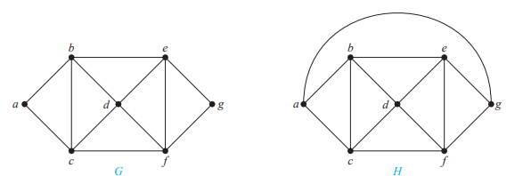
Chromatic number:
A graph can be colored by assigning a different color to each of its vertices. However, for most graphs a coloring can be found that uses fewer colors than the number of vertices in the graph. What is the least number of colors necessary?
The chromatic number of a graph is the least number of colors needed for a coloring of this graph. The chromatic number of a graph G is denoted by χ (G). (Here χ is the Greek letter chi.)
What are the chromatic numbers of the graphs G and H shown in Figure ?
: The chromatic number of G is 3, and H has a chromatic number equal to 4.

Slide 22
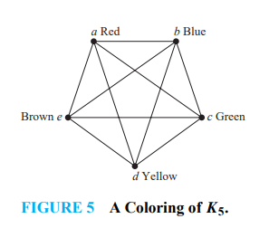
Chromatic number:
What is the chromatic number of K_{n}?
A coloring of K_{n} can be constructed using n colors by assigning a different color to each vertex.
Is there a coloring using fewer colors? The answer is no. No two vertices can be assigned the same color, because every two vertices of this graph are adjacent.
Hence, the chromatic number of K_{n} is n. That is, χ (K_{n}) = n.
A coloring of K₅ using five colors is shown in Figure .

Slide 23
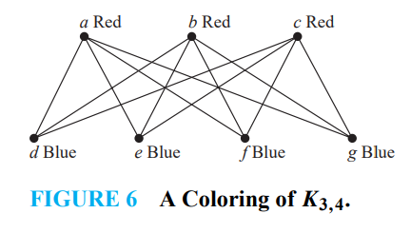
Chromatic number:
What is the chromatic number of the complete bipartite graph K_{m,n}, where m and n are positive integers?
We can color the set of m vertices with one color and the set of n vertices with a second color.
Because edges connect only a vertex from the set of m vertices and a vertex from the set of n vertices, no two adjacent vertices have the same color.
Hence, chromatic number of the complete bipartite graph is 2 i.e. χ (Km,n) = 2
A coloring of K_{3,4} with two colors is displayed in Figure.

Slide 24
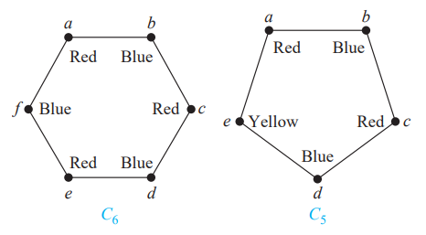
Chromatic number:
What is the chromatic number of the graph C_{n}, where n ≥ 3? (C_{n} is the cycle with n vertices.)
χ (Cn) = 2 if n is an even positive integer with n ≥ 4
χ (Cn) = 3 if n is an odd positive integer with n ≥ 3.
The chromatic number of C₆ is 2
The chromatic number of C₅ is 3

Slide 25
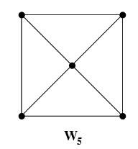
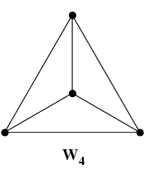
Chromatic number:
What is the chromatic number of W_{n}?
χ (Wn) = 4 if n is an even positive integer with n ≥ 4
χ (Wn) = 3 if n is an odd positive integer with n ≥ 5.
Red
Blue
Red
The chromatic number of W₅ is 3
The chromatic number of C₄ is 4
Green
Yellow
Blue
Red
Blue
Green

